Slide 1


A project presentation on gen-z’s Career Aspirations & key findings
Presented by : Prince Sharma (Data analyst intern)

Slide 2
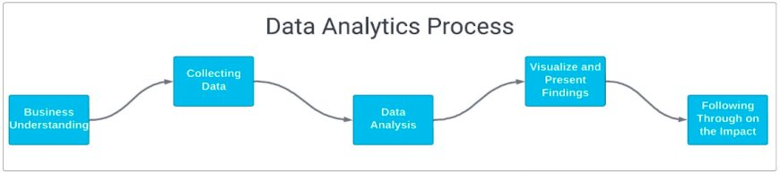
Whole Data Analytics process

Slide 3

AGENDA
Introduction
.project overview
2. Survey & Dataset
3. Objective
4. Methodology used
. Data collection
. Data Analysis
. Visualisation
5. Data Visualization
6. Findings and Insights
7. Recommendations for stakeholders

Slide 4

Introduction
Project overview
Objective: understanding career preferences, industry choices, and workplace expectations of Gen-z professionals
. Scope: Data analysis on Gen-z job preferences, industry choices, and workplace expectations.
. Data source: Extracted from culture hire database.
. Key Deliverables: Trends, career patterns, and recommendations for hiring strategies.

Slide 5
2. Survey & Dataset
.The survey was designed to capture diverse insights from
Gen-z professionals across different demographics and
Geographic locations. It was structured to include both
Qualitive and quantitative responses, focusing on
Understanding their aspirations, preferences, and motivations.
. Respondent Demographics:
.Geography: The majority of responses were from India.
. Gender: Included a balanced representation of male , female, and other genders, ensuring inclusivity
.Age Group: Targeted primarily at Gen z individual (18-26 years)
.This design ensures a robust representation of the Gen z cohort,
Providing a reliable foundation for actionable insights

Slide 6
3. Objective
1. Identify Learning Aspirations Understand Gen Z’s preferred learning modes,
Influencing factors, and higher education goals.
2. Explore Leadership preferences : Highlight the managerial qualities Gen Z values for an optimal work environment.
3. Examine Mission Alignments: Assess the importance of mission clarity in driving
employee satisfaction and engagement.
4. Deliver Actionable Insights: Provide recommendations to help business adapt
Their strategies to Gen z’s career expectations.

Slide 7

4. Methodology Used
Data collection: Extracted from culture hire database containing 1,20,00+ career preferences from Gen-z Professionals
Cleaned and processed using Excel and SQL queries.
Data Analysis Identified patterns and trends using statistical methods Exploratory Data analysis (EDA) for insights
Visualization: Created charts, graphs, and dashboards for better Interpretation using Excel and Power BI.

Slide 8
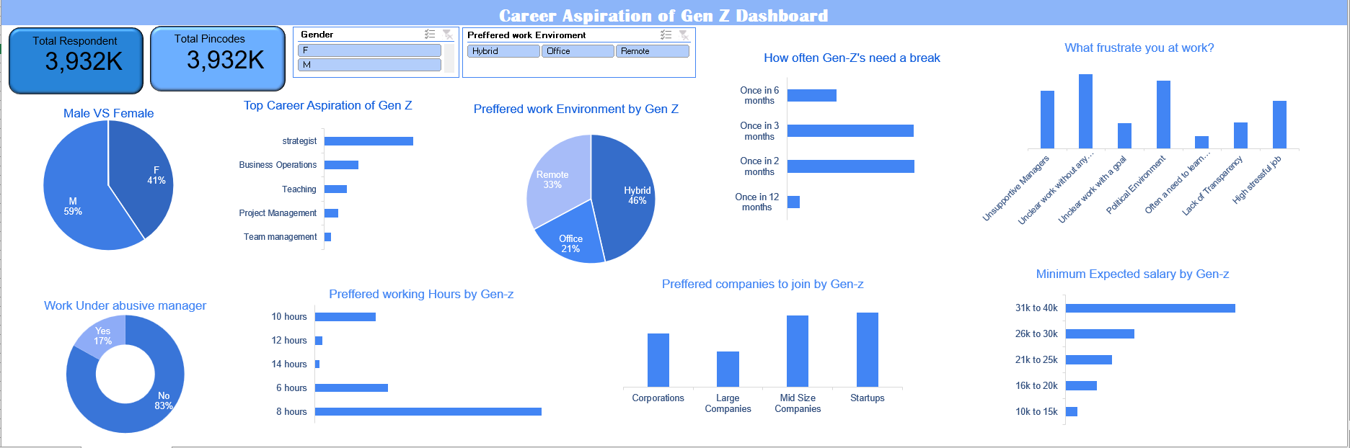
5. Data Visualization Using Excel

Slide 9
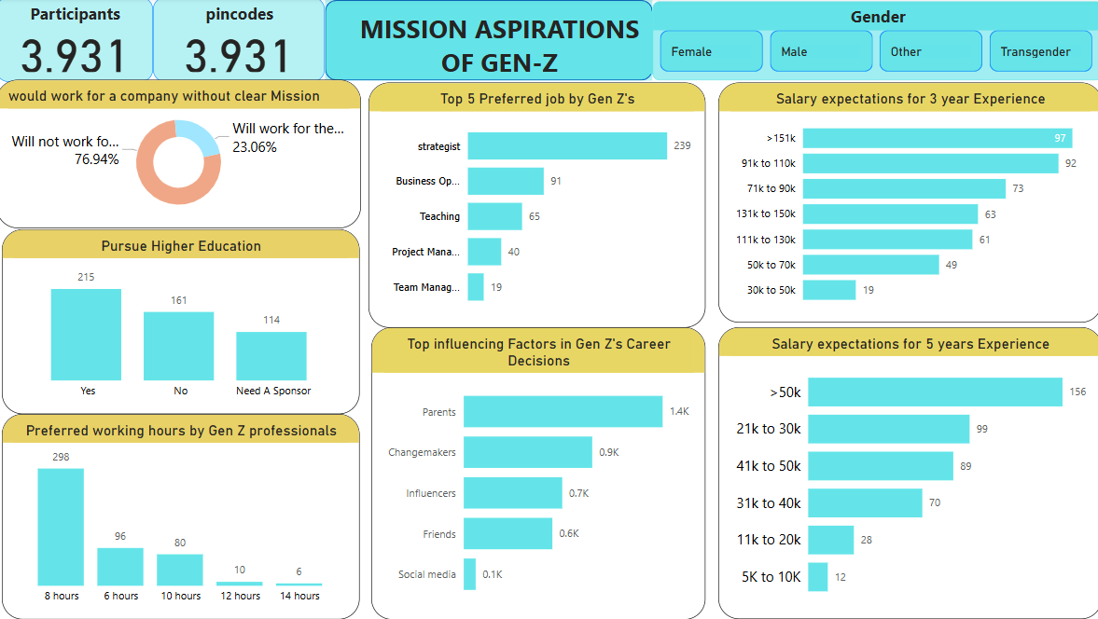
5. Data Visualization Using Power Bi

Slide 10
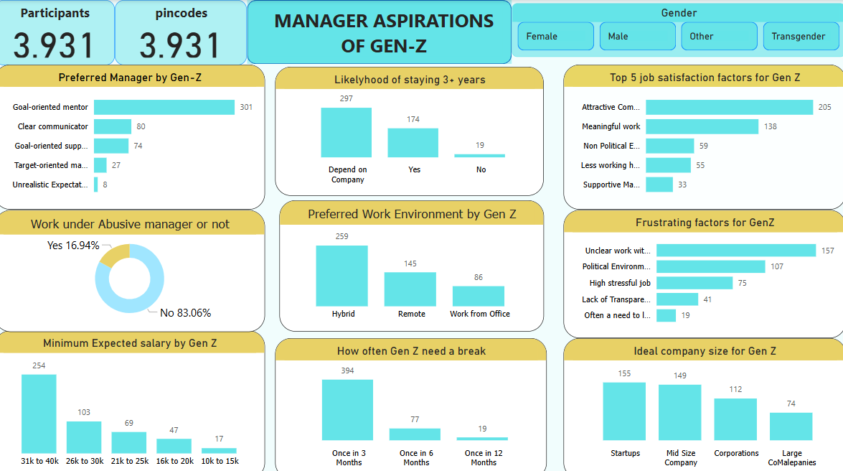
5. Data Visualization Using Power Bi

Slide 11

6. Findings and Insights
The analysis of Gen Z’s career aspirations and workplace expectations revealed several important trends:
1.Learning Aspirations:
. A strong preference for structured yet flexible learning environments, with Expert-Led programs the top choice.
. 67.65% aspire to higher education, but affordability remains a key concern for a significant portion
2. Career preferences:
. Gen Zis drawn to creative, analytical, and management-focused roles, with Design & strategies , Data analytics, and Business
operations dominating career choices.
. Traditional industries like Cybersecurity, BPO Services, and Sales & Marketing are less favoured.
3. Managerial Expectations :
.Employees value managers who provide Clear goals, supportive leadership , and transparency, emphasizing the need for
structured leadership practices.
4. Mission Alignment:
.misaligned missions lead to frustration like unclear goals and lack of transparency, highlighting the critical importance of
organizational Clarity.
5. Workplace Trends:
. The majority are open to long-term tenure when organizations prioritize mission alignments and transparency, demonstrating
resilience and adaptability.
These findings offer valuable insights into Gen Z’s priorities, enabling organizations to align their strategies for attracting and retaining young talent effectivity

Slide 12
7. Recommendations for stakeholders
1.Foster Transparent Leadership:
. Cultivate clear communication Channels and set well-defined goals to enhance employee trust and
satisfaction
2. Invest in Learning opportunities:
. Offer expert-led programs, self-paced learning, and observation-based training to meet Gen Z’s
diverse learning preferences.
3. Support Higher Education Aspirations:
. Provide sponsorship or education assistance programs to address affordability concerns and
encourage skill development.
4. Align organizational Missions:
.Ensure the company’s mission aligns with employees values to reduce frustration and foster loyalty.
5. Create Rewarding work Environments:
. Balance high-pressure tasks with meaningful rewards and learning-focused support to drive
engagement and professionals growth.

Slide 13


Thank you
Open for questions and discussions
Prince Sharma (Data analyst intern)
Prince.analyst25@gmail.com
WWW.kulturehire.com

